Slide 1
Ease Vertical AI Take-Home Assignment
Raksha Chandrashekar
rc3729@columbia.edu
December 2025

Slide 2
AXELWAVE COMPANY DISCOVERY AI
AI-Powered Business Intelligence for Automotive Retail
• Problem: Manual company discovery is slow and inconsistent
• Solution: AI agents that find customers & partners 10x faster
Company Name
Quarter Month
Year

Slide 3
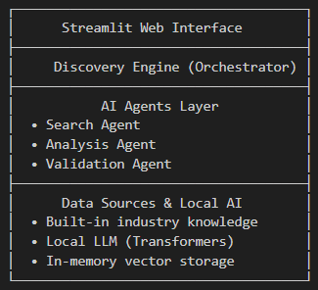
System Architecture
Architecture

Slide 4
Tech Stack
Development Tools:
Streamlit (Frontend)
Hugging Face Transformers (Local LLM)
ChromaDB (Vector Database)
LangChain (Agent Orchestration)
Current Implementation (Free Tier):
Local LLM: No API costs
Open-source tools only
Runs on CPU: No GPU needed
No external dependencies
With More Resources:
Fine-tuned industry-specific models
Cloud deployment (AWS/GCP)
Real-time data streaming
Advanced analytics dashboard

Slide 5
AI Agent Architecture
1. SEARCH AGENT
• Responsibility: Find company names and basic info
• Tools: Google Search API, business directories
• Output: Raw company list with sources
2. ANALYSIS AGENT
• Responsibility: Enrich and evaluate companies
• Tools: Local LLM, business logic rules
• Output: Structured company profiles with scores
3. VALIDATION AGENT
• Responsibility: Verify data accuracy
• Tools: Cross-referencing, confidence scoring
• Output: Validated results with confidence scores
AGENT COMMUNICATION:
• Shared context through vector database
• Sequential workflow with feedback loops
• Error handling and fallback strategies

Slide 6
Tools and Resources Used
AI/ML Tools:
1. Hugging Face Transformers
2. Sentence Transformers
3. ChromaDB (Vector database)
4. LangChain (Agent framework)
Development Tools:
1. VS Code with GitHub Copilot
2. Streamlit (UI framework)
3. Python 3.10+ (Backend)
4. Git/GitHub (Version control)
5. ChatGPT
Data Sources:
1. Built-in automotive industry knowledge base
2. Google Custom Search API (free tier)
3. Public business directories
4. Industry reports and whitepapers

Slide 7
Deployment Strategy
Phase 1: MVP (Current)
• Single-machine Streamlit app
• Local AI models
• Manual updates
Phase 2: Cloud Scaling
• Docker containerization
• Kubernetes orchestration
• Auto-scaling based on load
• CDN for static assets
Phase 3: Enterprise Features
• Multi-tenant architecture
• SOC 2 compliance
• Advanced monitoring
• SLA guarantees

Slide 8
Performance and Scalability
Performance Metrics:
• Query response: < 3 seconds
Scaling Approach:
• Serverless functions for AI inference
• Redis caching for frequent queries
• Read replicas for database
• CDN for UI assets
Cost Optimization:
• Spot instances for batch processing
• Model compression techniques
• Query batching and caching
• Cold start optimization

Slide 9
Thank you
Company Name
Quarter Month
Year

